Slide 1
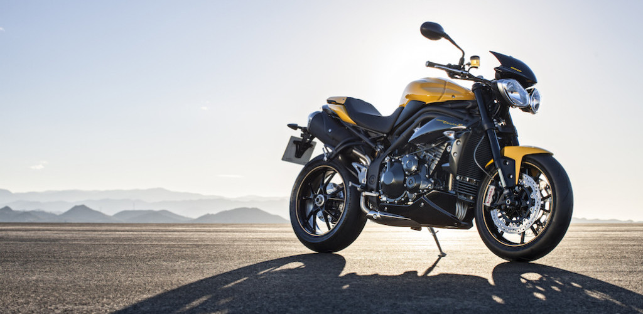
JEEVAN (G-1) BIKE INSURANCE
We care for your Dream

Slide 2

Team Members
Abhishek Gandhi
Akalya Anbazhagan
Deepa Nigam
Nilesh Kumar Mangnani
Siddharth Sahu

Slide 3
Overview
Jeevan Insurance is a bike insurance company based in Talawade, Pune. Our company provides insurance for only two wheeler vehicles for specific models.
In our company we provide basic package in which we provide benefits to vehicles which got damaged by accident (OD premium).

Slide 4
Brief Introduction about our company
JEEVAN INSURANCE IS A PRIVATE BIKE INSURANCE COMPANY STARTED IN 2017. IT DEALS WITH THE CLIENT FOR BIKE INSURANCE OF PREMIUM PER YEAR. A CLIENT GETS THE NCB(NO CLAIM BONUS) ONLY IF HE/SHE HAS NOT CLAIMED FOR INSURANCE IN PAST YEARS.
OUR COMPANY DEALS WITH THE THIRD PARTY INSURANCE AND COMPREHENSIVE INSURANCE (OR STANDARD INSURANCE). EVALUATION OF VALID AND INVALID INSURANCE IS DONE.
CALCULATION OF PREMIUM IS DONE ON THE BASIS OF FEW FACTORS LIKE DAMAGE CAUSED TO THE VEHICLE, YEAR INSURED AND FEW OTHER FACTORS.
CLIENT CAN BROWSE HIS DETAILS AND TERMS AND CONDIIONS OF THE COMPANY IN SEPEARTE SECTIONS. EVERY CLIENT HAS BEEN PROVIDED WITH A UNIQUE LOGIN ID AND PASSWORD.

Slide 5
Why Jeevan Insurance
We provide insurance according to situation and condition of vehicle.
The people who have not claimed for 3 years gets NCB for two years (2nd and 3rd year).
We have specialty in servicing claims to settle them fast.
It is a simple and fast way to get your vehicle insured with minimum details required.

Slide 6
Our application
We also have an application in which we provide information to our clients about there vehicle insurance.
This application is for two types of people, one is Administrator who can Add, Update, Delete or Browse Clients data, and other is client who can only browse his/her data.
By our application clients can view the information of there vehicles such as registration year, number of claims, expiry year, etc.

Slide 7
Assumptions Made In Our Applications
INSURANCE COMPANY- JEEVAN (G-1) INSURANCE.
ONLY FOR BIKE INSURANCE OF 3-4 MODELS.
ONLY CLIENT AND ADMIN ACCESS.
ON DAMAGE PREMIUM IS CALCULATED ON THE BASIS OF REGISTRATION YEAR AND STARTING YEAR OF INSURANCE.
INSURANCE IS ONLY FOR 3 YEARS.

Slide 8
Assumptions (continue)
CLAIM DATE IS GREATER THAN THE COMPANY OPENING DATE AND BIKE PURCHASE DATE.
PREMIUM IS CALCULATED PER YEAR AND IS TO BE PAID BY THE CLIENT (THROUGH OFFLINE PROCESS).
BENEFIT IS PROVIDED WHEN THERE IS ANY DAMAGE TO THE BIKE.

Slide 9
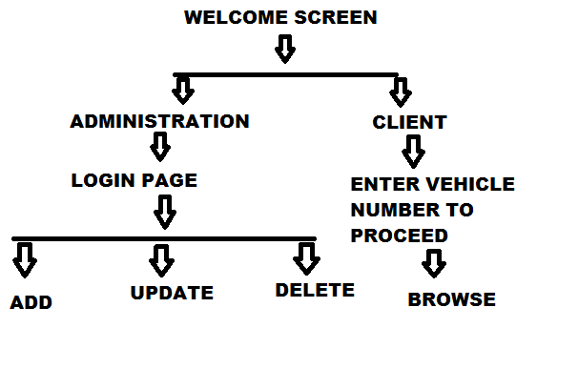
Our batch Diagram
Notes:
Details about our application:-
The first screen of our application is welcome screen. In this screen there are three options Administrator, client, and Terms and Conditions.
The second screen is divided into two parts (Admin and Client)
Administrator
In administrator screen there are fields of Login and Password. Admin has to provide correct Login Id and Password to go to next screen.
In next screen the Administrator and Add, Update or Delete the Clients details.
Client
In client screen there is a field of Entering a Vehicle Number.
By entering his/her vehicle number client can browse there information related to insurance (Client as no access to edit or add information).

Slide 10
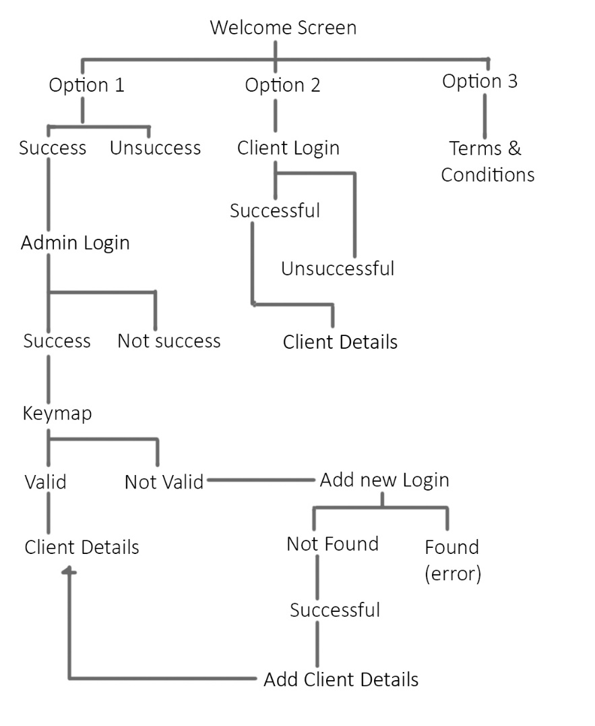
Sequence Diagram

Slide 11
Screens of our applications

Slide 12
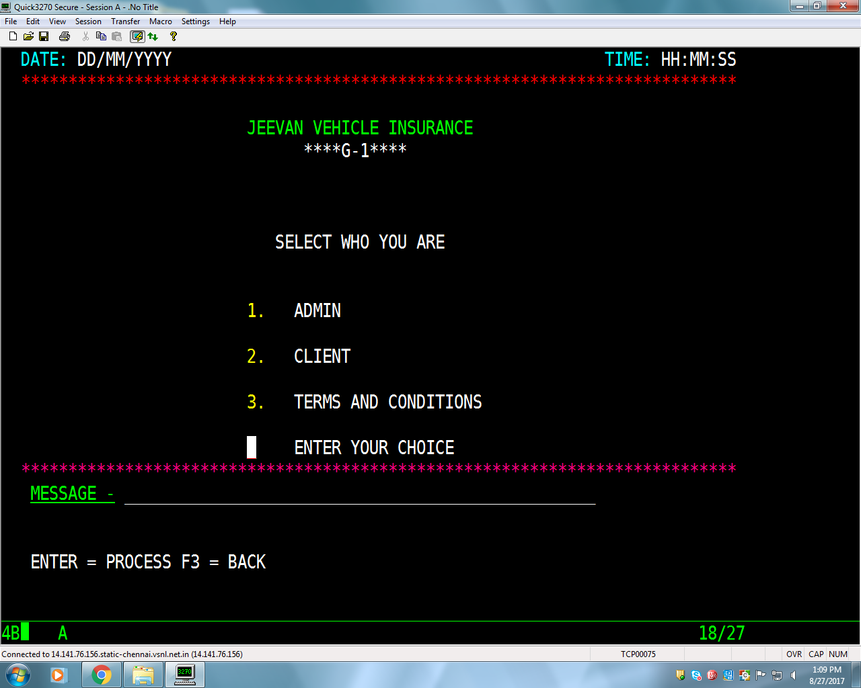
Notes:
This is the first Screen of the Application.
In this screen we can choose the option between Admin, Client and Terms and Condition.

Slide 13
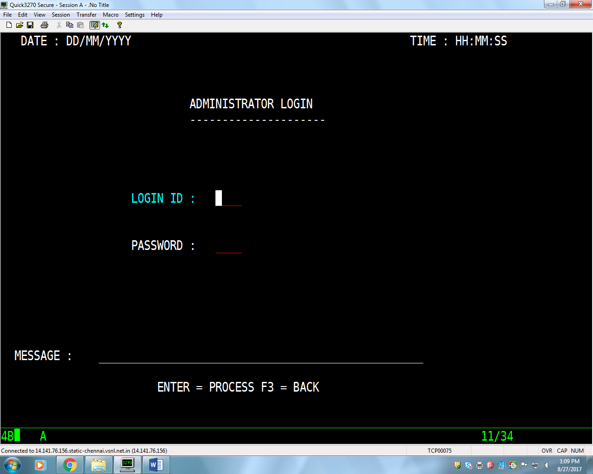
Notes:
In this screen Admin and Login by using his/her valid Login Id and password.
The user can also go to previous screen to pressing F3 button.

Slide 14
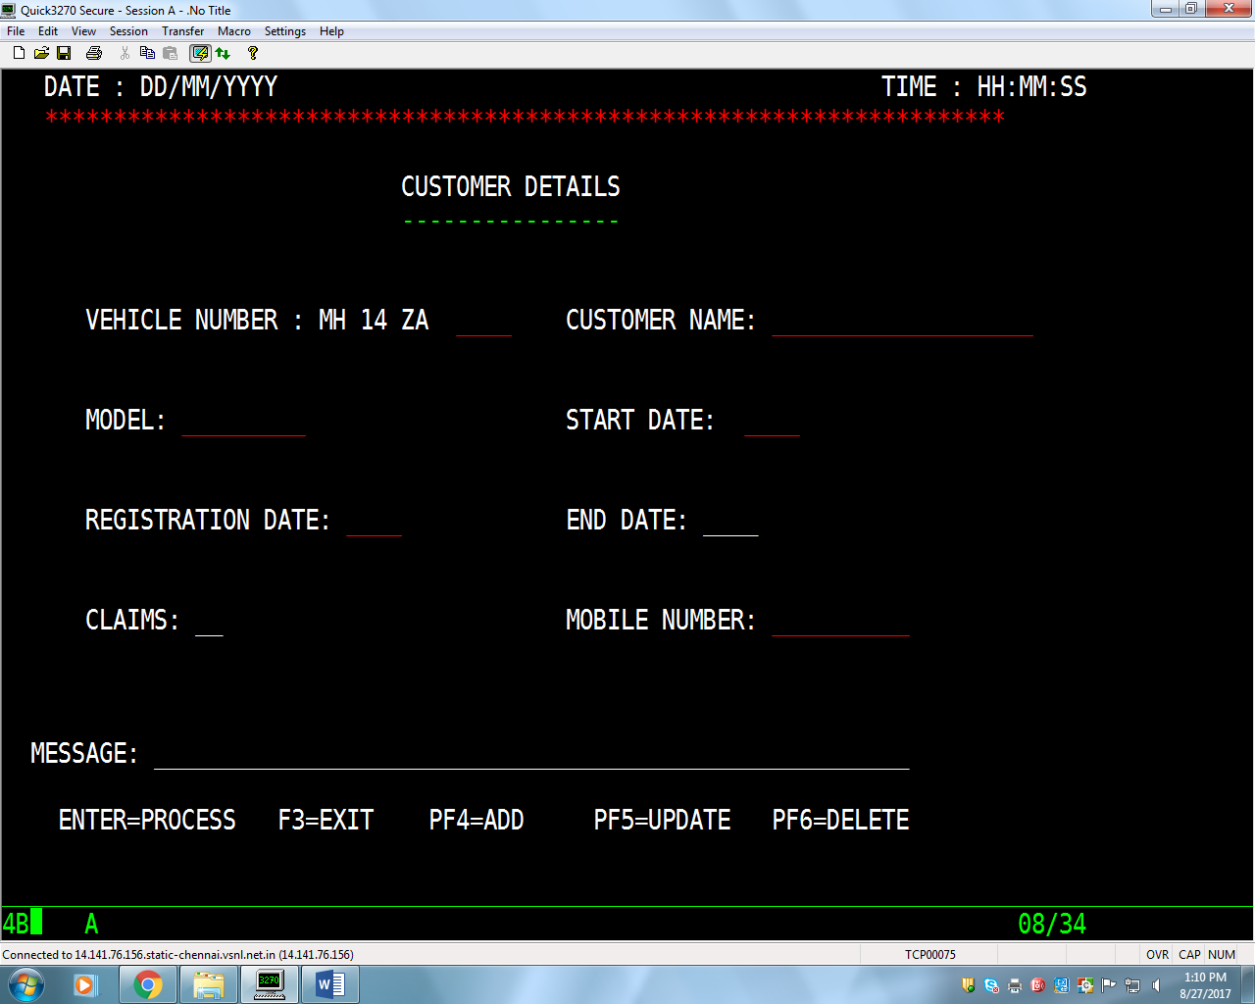
Notes:
Customer Details screen for Adminstrator.
In this screen Administrator can Add, Update or Delete the Client Data.
Button Functionalities-
To exit (Go to previous screen) – F3
To add the client details - F4
To update the client details – F5
To delete the client details – F6

Slide 15
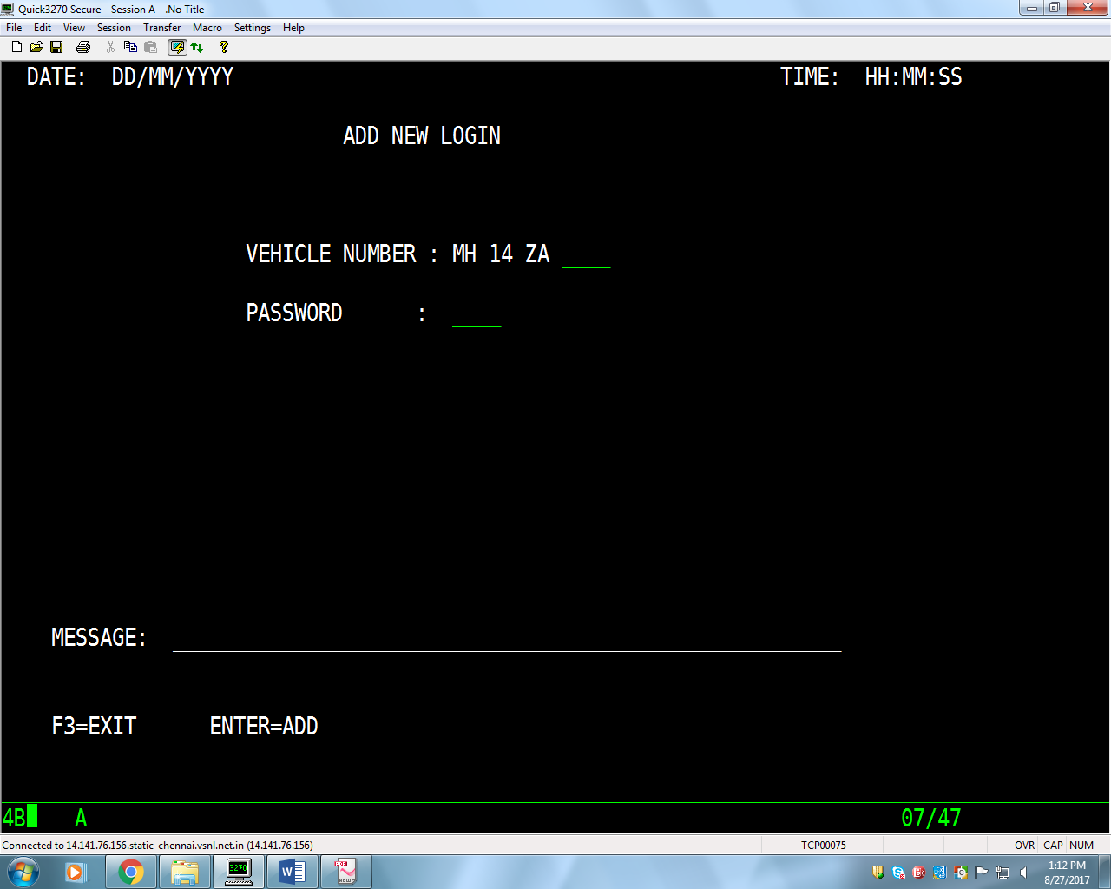
Notes:
In previous screen if Admin enter the vehicle which does not exist then he/she will automatically redirected to this screen. In this screen Admin can create a new Id by inserting Vehicle Number and Password.

Slide 16
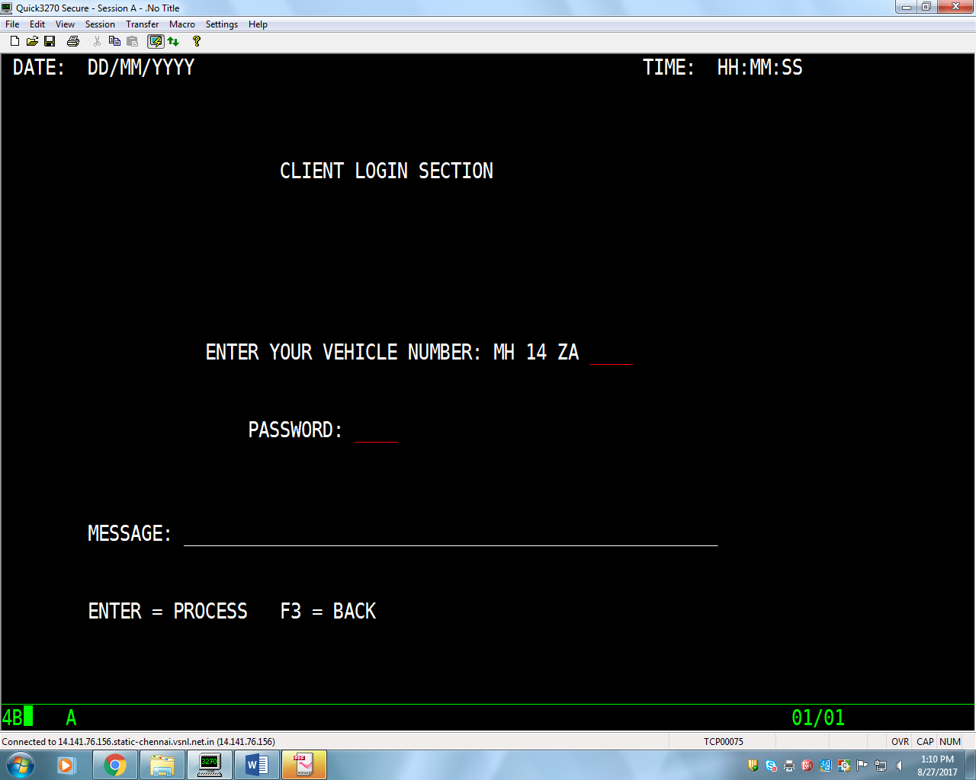
Notes:
In this screen Client can Login by inserting his/her Vehicle Number and Password.
If the user had inserted wrong details then he/she cannot proceed screen the message will displayed of entering Invalid details.

Slide 17
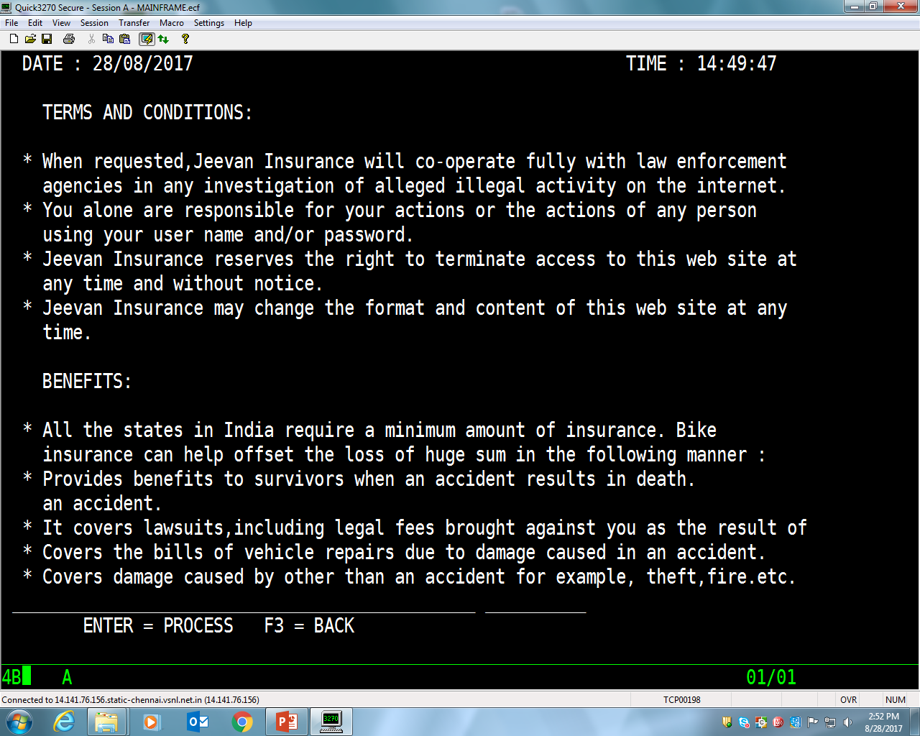
Notes:
Terms and Conditions Screen

Slide 18
Validations Used In Our Application
Mobile numbers should be of 10 numbers only.
The First Three column of Vehicle number are static and last column contains 4 numbers.
Date should be numeric, and registration date should not be less than 2015.
The date of claiming the vehicle should be greater then starting date of insurance.
The period of starting date and ending date should be 1 year.
Vehicle Number should be numeric, non spaces, non-zero and should contain only 4 digits.
Customer name should not be numeric and non-zero.
Model number should be 150, 200, 220.
Model number should not contain any spaces or zeros.

Slide 19
THANK YOU

